Slide 2
King Mongkut's University of Technology Thonburi (KMUTT) Bangkok, Thailand
ENVIRONMENTAL FRIENDLY
AND MACHINABLE
LEAD-FREE BRASS
BY
PEMIKA SUKSONGKARM
SIRINTRA JITCHOOM
KUNTHARA POONJARUWAT

Slide 3

Do you know that your drinking
water contains lead?
In 2004, 143,000 deaths
and 8,977,000 diseases were
caused by Lead exposure

Slide 4








HEALTH IMPACTS OF LEAD
DAMAGES
Abnormal functions
and damages
Brain
Kidney
Liver
Blood
Reproductive
System
Young children
Absorb 4-5 times more
than adults which can cause:
Adults
Lead exposure increases
the risk of:
Pregnant women
Lead exposure affects:
Ischaemic heart
disease stroke
, which can cause:
The developing
fetus
Intellectual disability
Underperforming at school
Behaviour issues

Slide 5
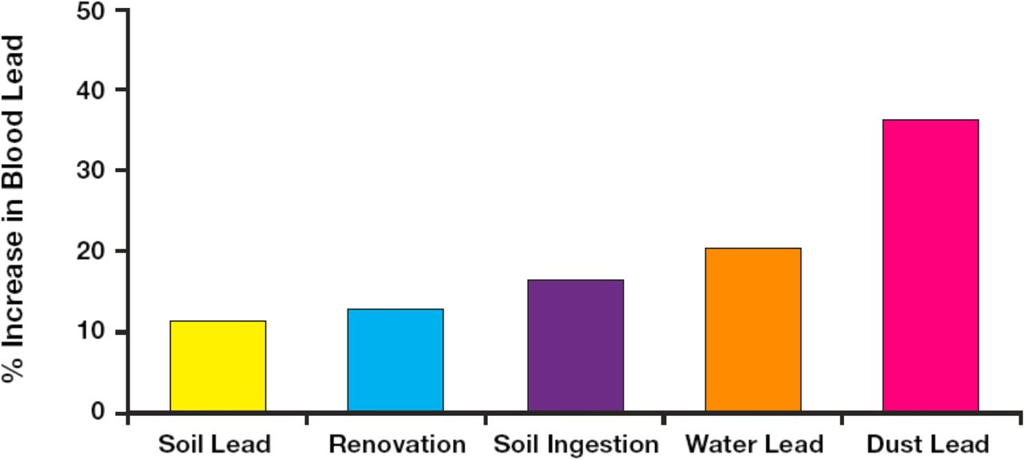
PERCENTAGE OF SOURCES
LEAD IN BLOOD
% Increase of LEAD in blood

Slide 6
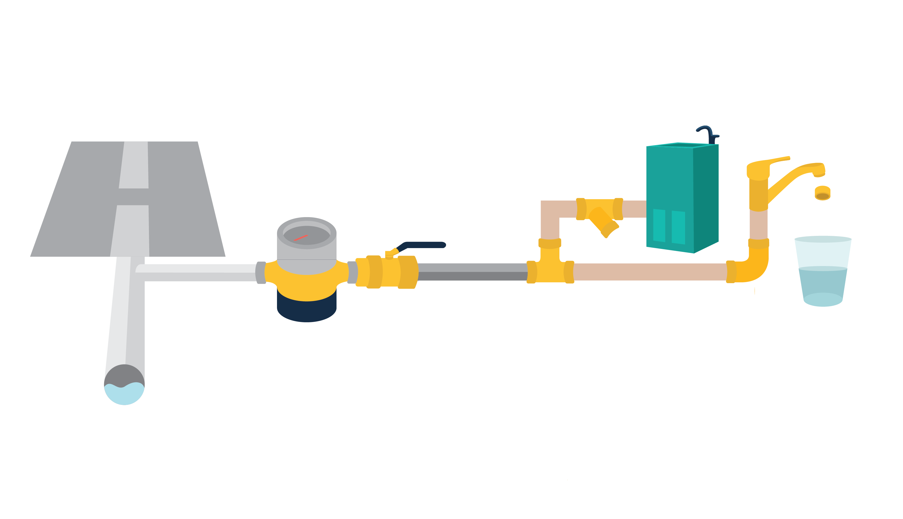
SOURCES OF LEAD IN DRINKING WATER
WATER DISTRIBUTION SYSTEM
Brass faucet
Water fountain
Aerator
Water
meter
Strainer
Galvanized
iron
Valves
Lead solder joints

Slide 7





SOURCES OF LEAD IN DRINKING WATER
WATER DISTRIBUTION SYSTEM
Brass faucet
Water fountain
Aerator
Water
meter
Strainer
Galvanized
iron
Valves
Lead solder joints
Brass
Lead

Slide 8

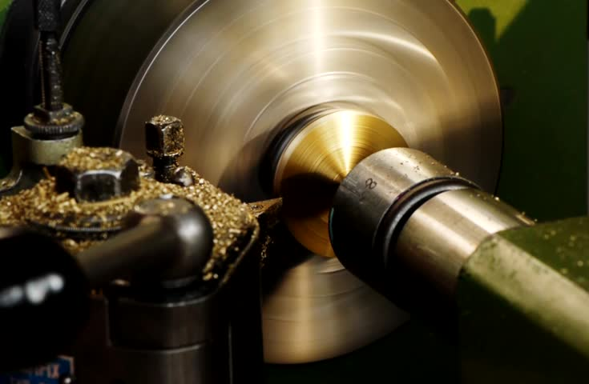




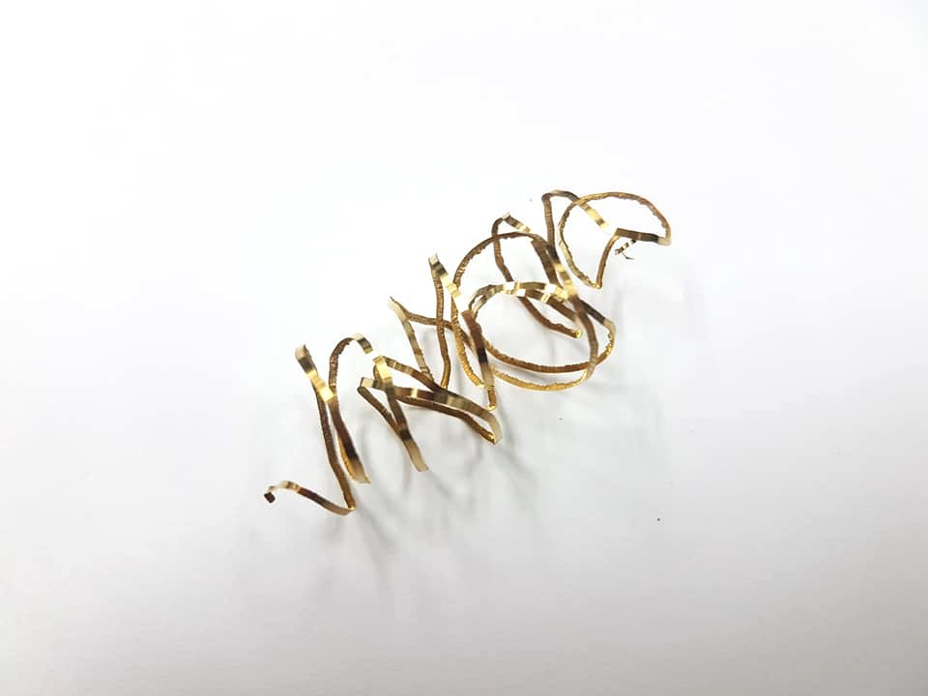
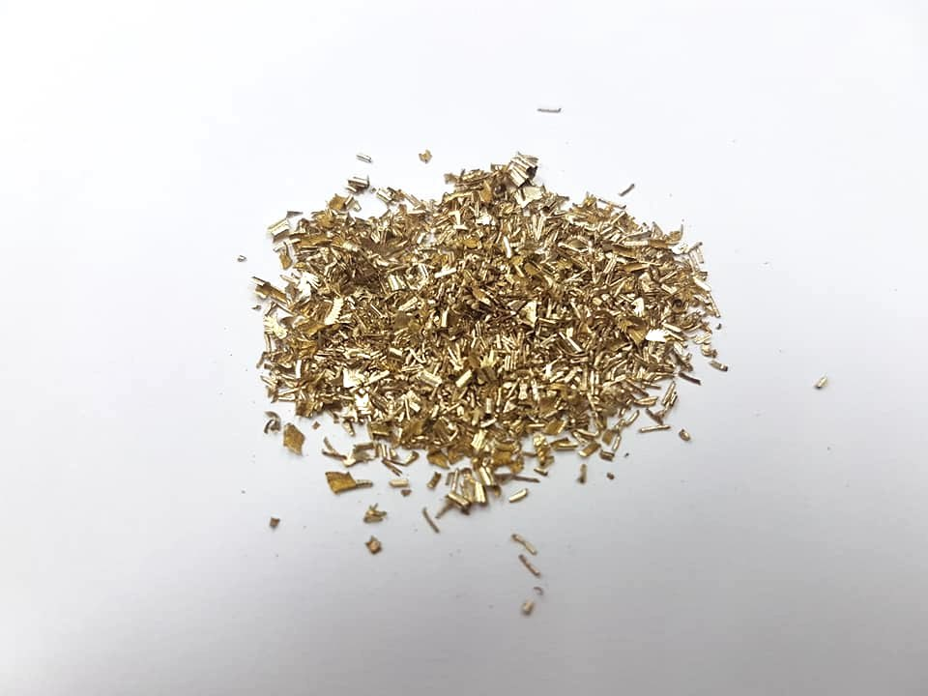


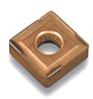

WHY BRASS CONTAIN LEAD?
BRASS MANUFACTURING PROCESS
Brass
Product
, which can cause:
Lead
Chips
Cutting tools
Short chips

Slide 9
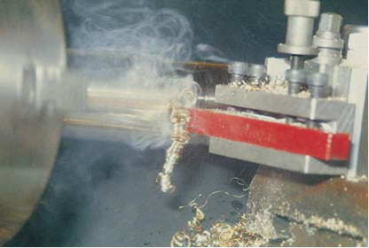

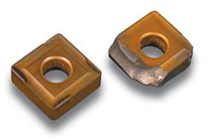

Chips
BRASS WITHOUT-LEAD?
BRASS MANUFACTURING PROCESS
Brass
Product
, which can cause:
Lead
Chips
Damage cutting tools
.
Long chips

Slide 10

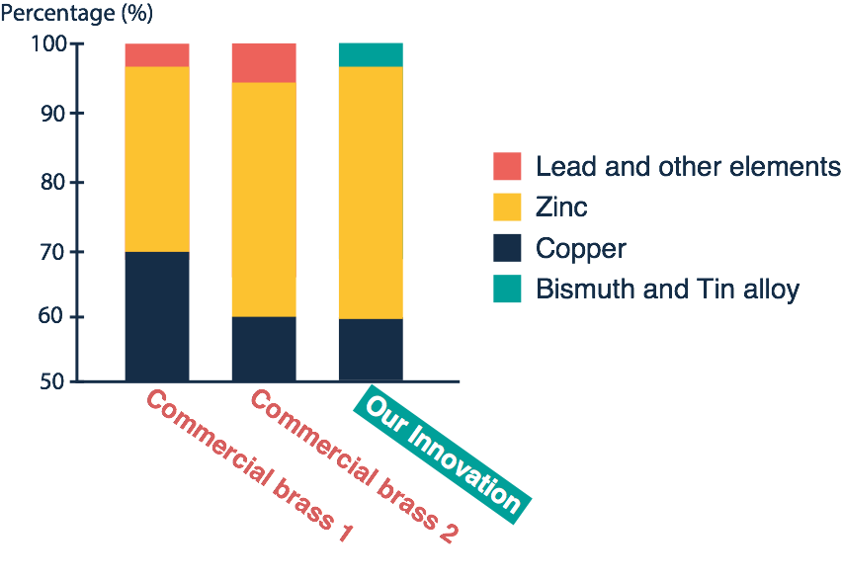
COMPETITORS
BRASS WITHOUT-LEAD IN MARKET
Copper and other elements
costs are more expensive
than Lead-Free Brass

Slide 11
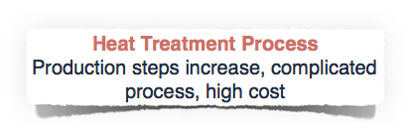
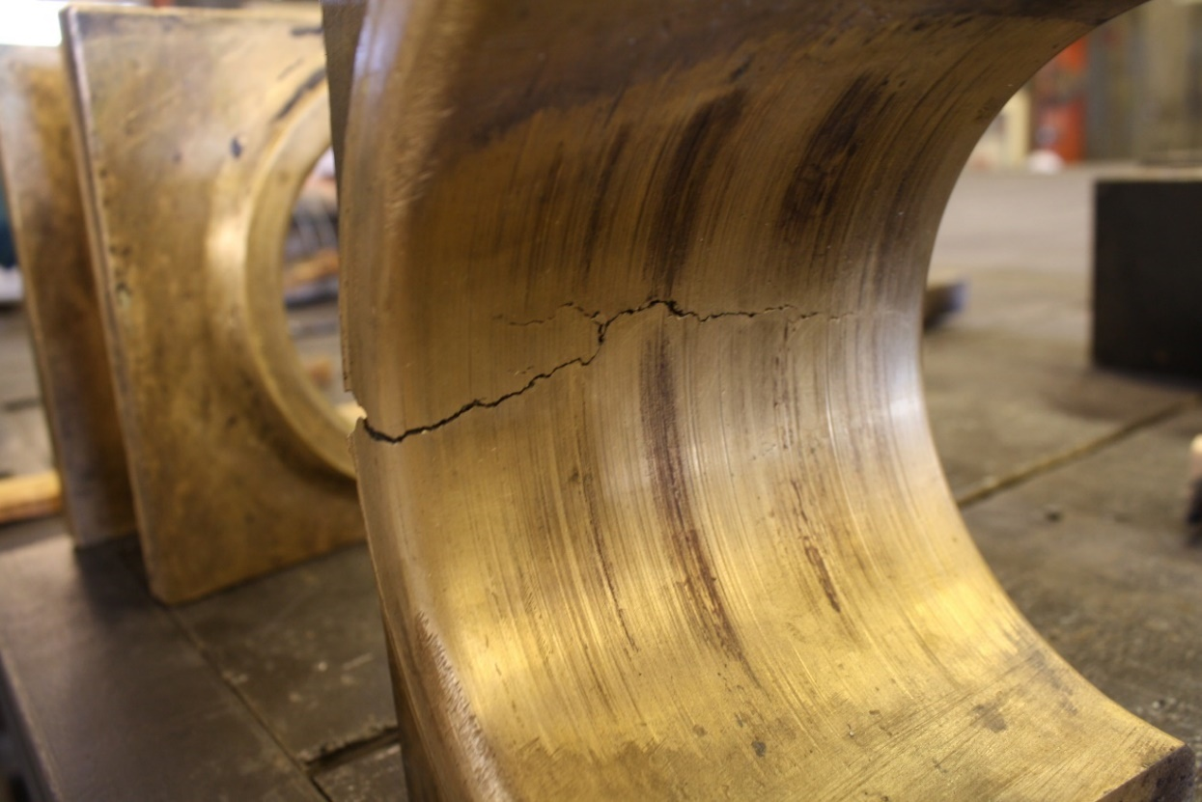
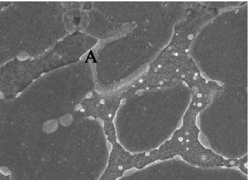
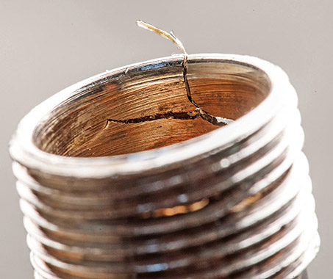
EXISTING SOLUTIONS
WHICH ELEMENTS CAN REPLACE LEAD?
Mechanism of crack
and low machinability brass
After casting
Bismuth film
After machining

Slide 12
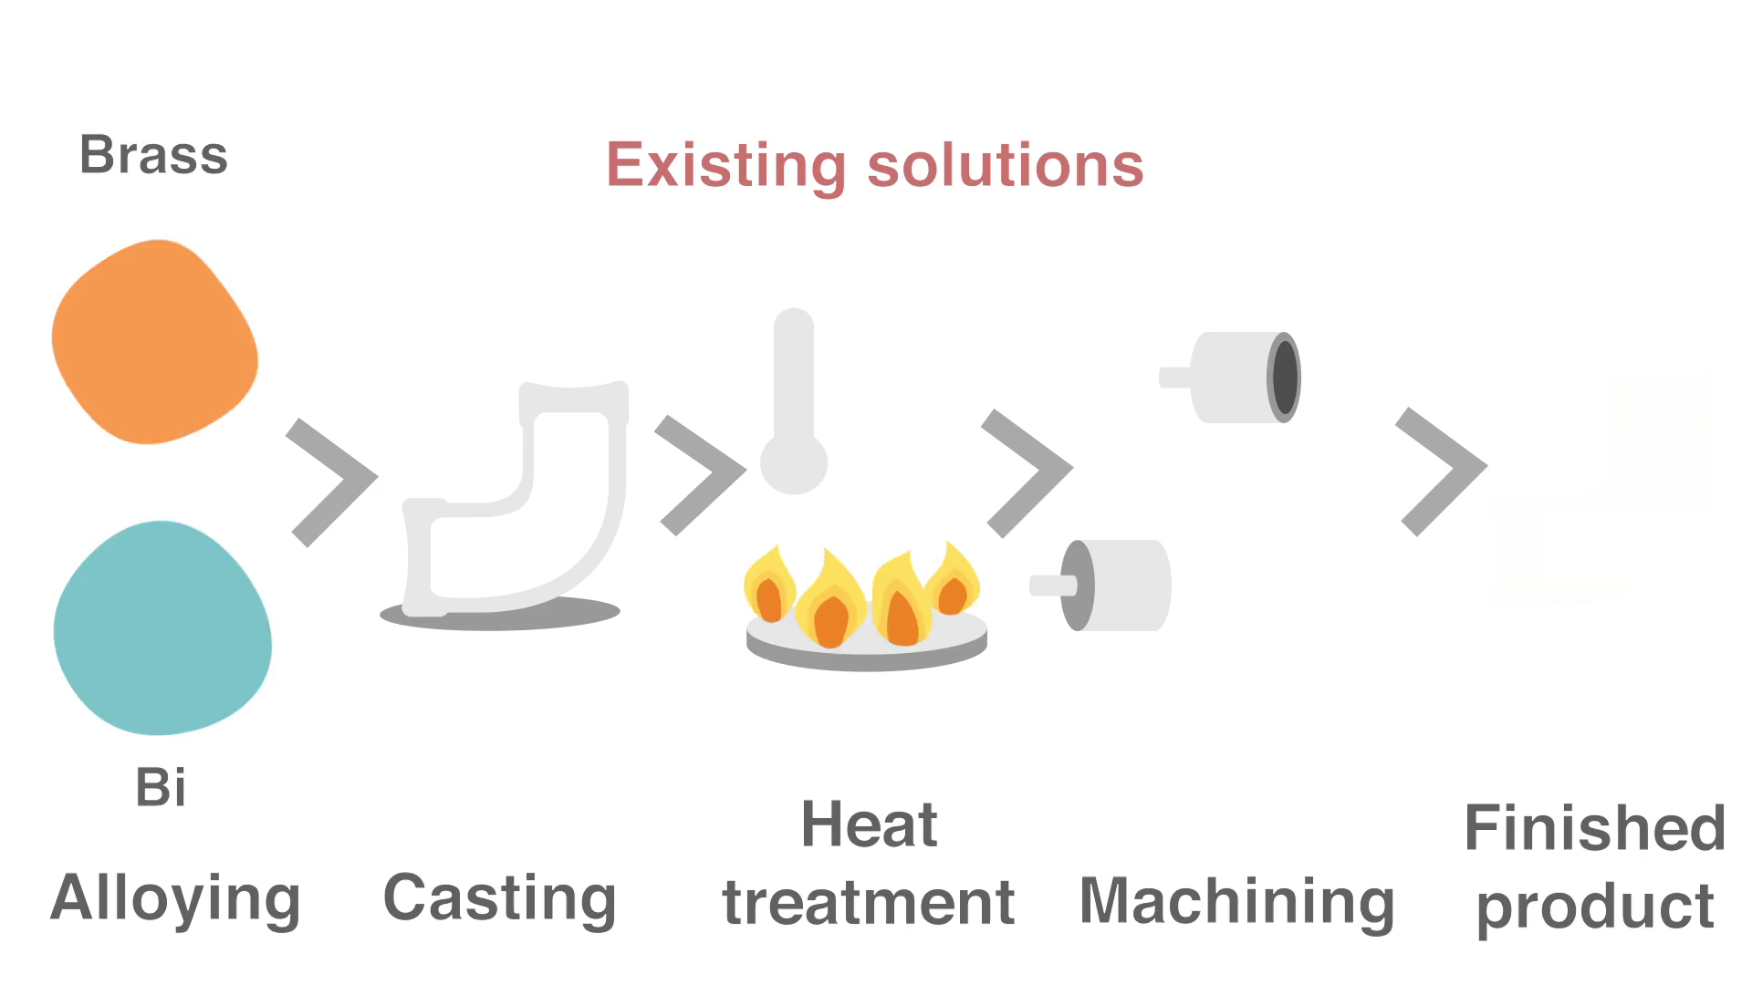
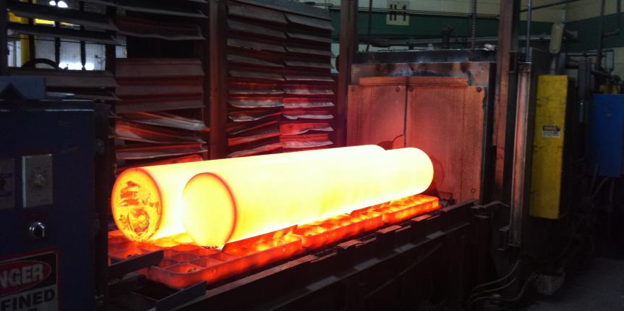
EXISTING SOLUTIONS
WHICH ELEMENTS CAN REPLACE LEAD?
Heat treatment
High cost
Complicated process
Increase production steps

Slide 13
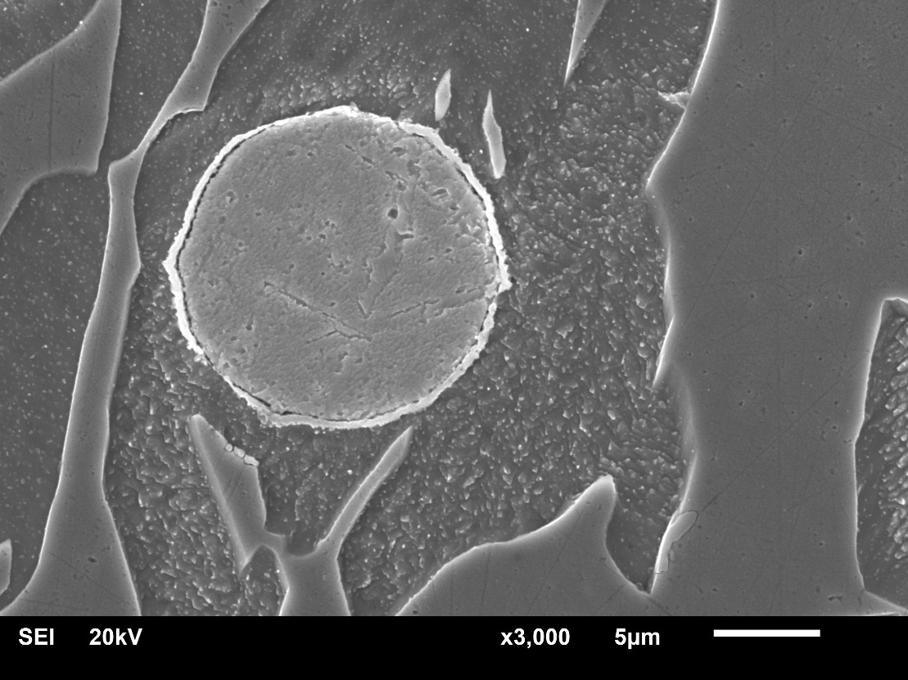
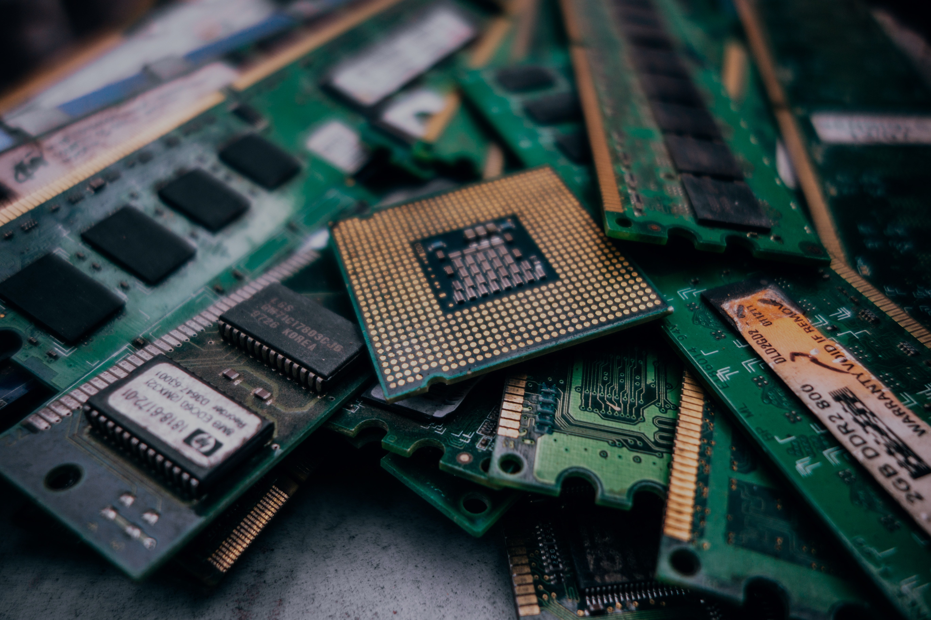
OUR INNOVATION
LEAD-FREE BRASS
Mechanism of crack prevention
and machinability
Brass
Beta
SOLDER WASTE
(Bi-Sn alloy)
LEAD-FREE
BRASS
Bismuth
Alpha
• Higher performance
• Lower cost
• Simpler process
Bismuth particles embedded in
alpha phase only

Slide 14


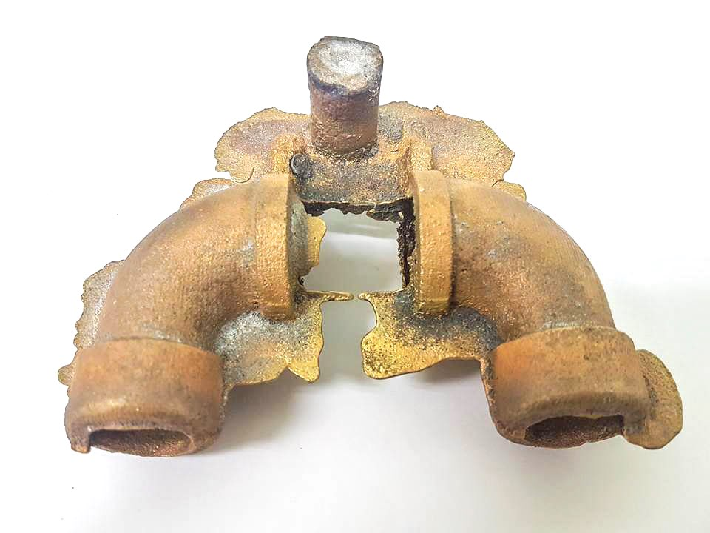
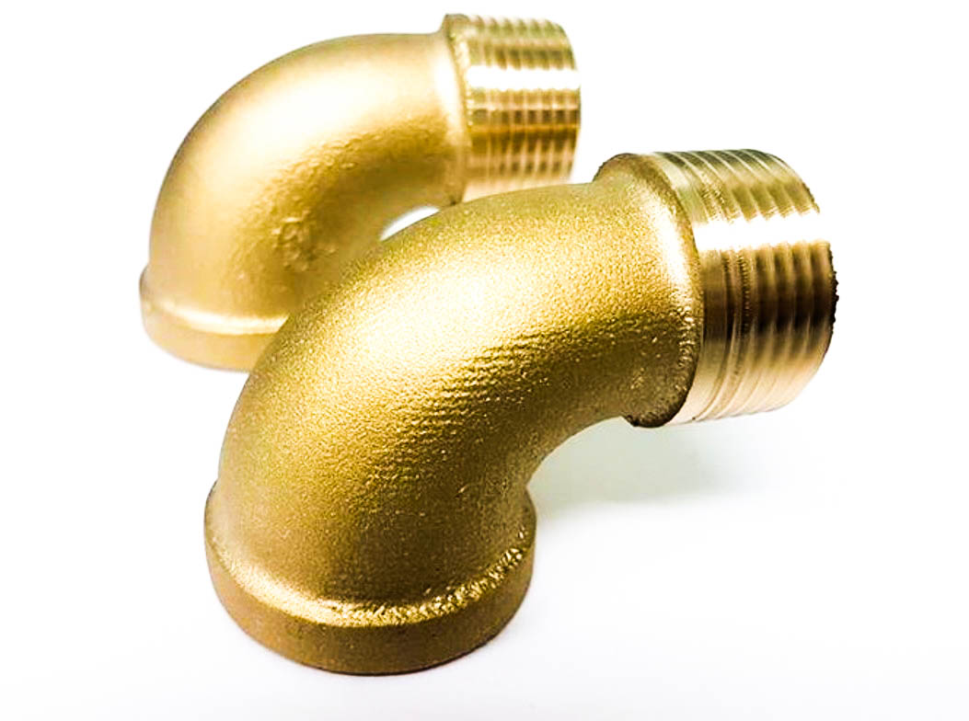

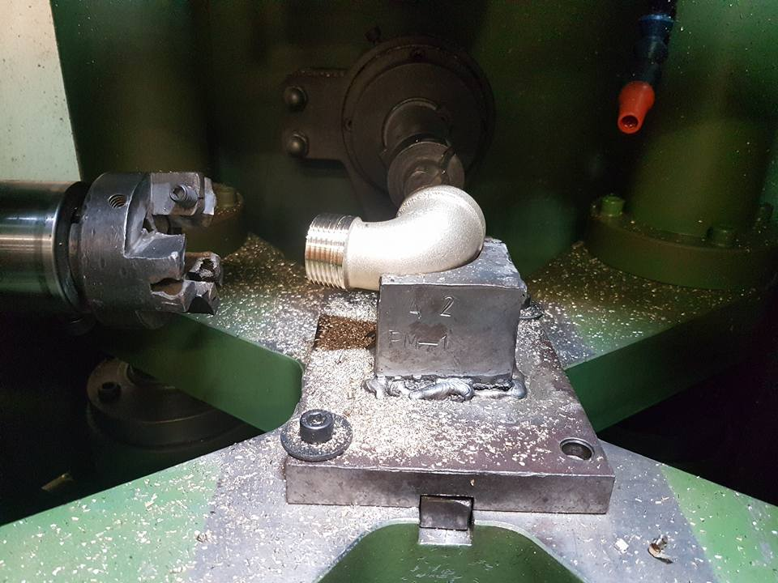

OUR INNOVATION
LEAD-FREE BRASS
After casting
After machining
• No cracks after machining
• No cracks after casting
• Not subject to any heat treatment
Short chips

Slide 15
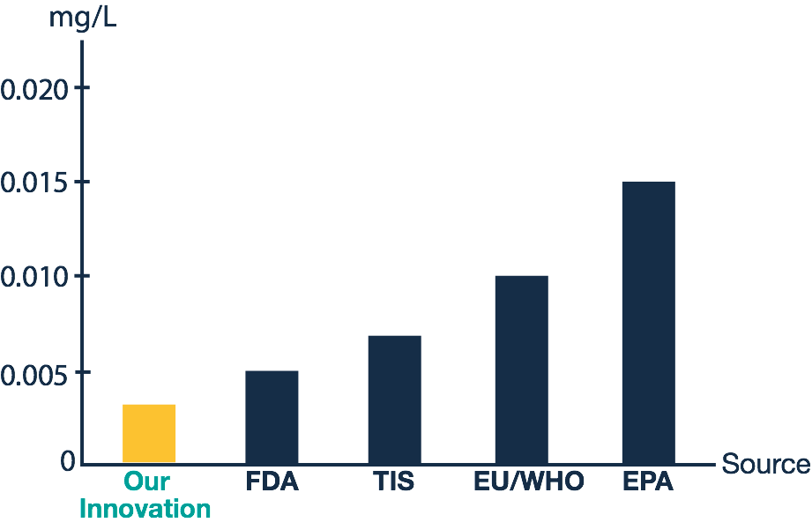
REGULATORY LIMITS
LEAD IN WATER
Poisonous Level
Validation
Our technology has been validated by theThai Industrial
Standard (TIS) for reducing the quantity of toxic elements

Slide 16




OUR INNOVATION
WHY LEAD-FREE BRASS?
Lead-Free
Reduce contamination
in environment and
damage in human healths
E-Waste Reuse
Decrease amounts
of E-Waste and add value to them
Low Cost
Cost much less
than all the existing
lead-free brass
in the market
High Productivity
Improve the
machinability, the
durability of the cutting tool and crack prevention.

Slide 17
APPLICATIONS
LEAD-FREE WATER SUPPLIES
Water meter
Valves
Aerator
Strainer
Solder joints

Slide 18
APPLICATIONS
LEAD-FREE PRODUCTS
Kitchenwares
Music instruments
Decorative

Slide 19



OUR PARTNERS
BUSINESS CORPORATION
Smile Brass Co.,LtD.
TH Patent Application Number 1601005552
Yontrakarn Metalwork Co.,Ltd

Slide 20



Slide 21
THANK YOU

